Slide 1

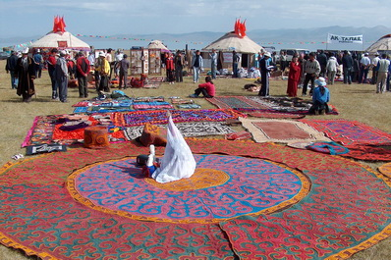
Positive Peace in Schools
Professor Hilary Cremin
Roy Leighton
MPhil (Cantab) F.R.S.A.
Head, Faculty of Education
English Version
Creative Director
Cambridge University
Positive Peace Cambridge

Slide 2
Those involved with the education of others should become fully aware of all expressions of violence and peace in order to offer an education that is fit for purpose for the twenty-first century.
Hilary Cremin & Alexandra Gulherme Violence in Schools: Perspectives (and hope) from Galtung and Buber.
Educational Philosophy and Theory. Volume 48 - Issue 11

Slide 3
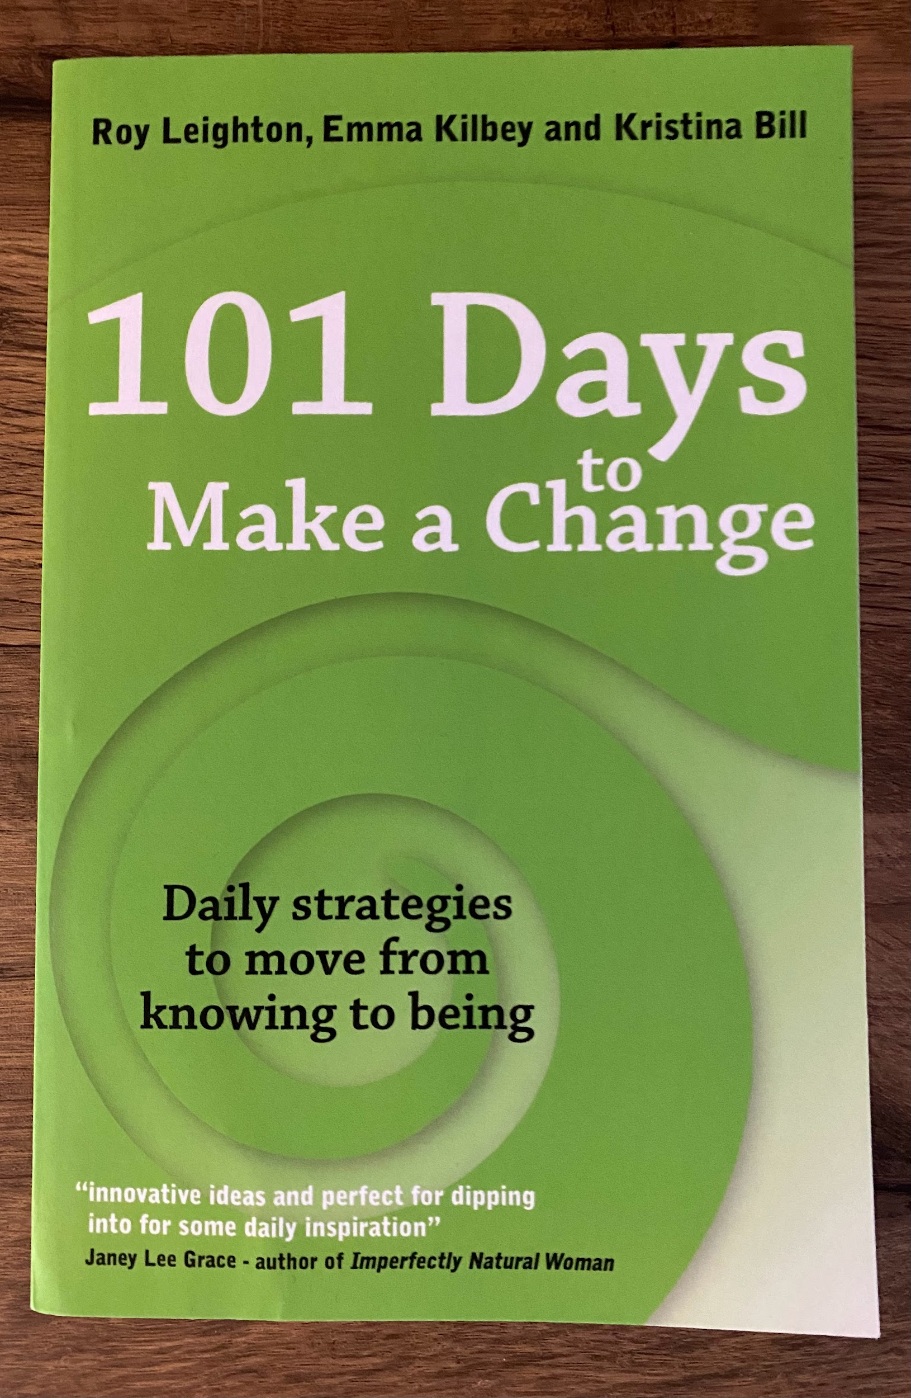
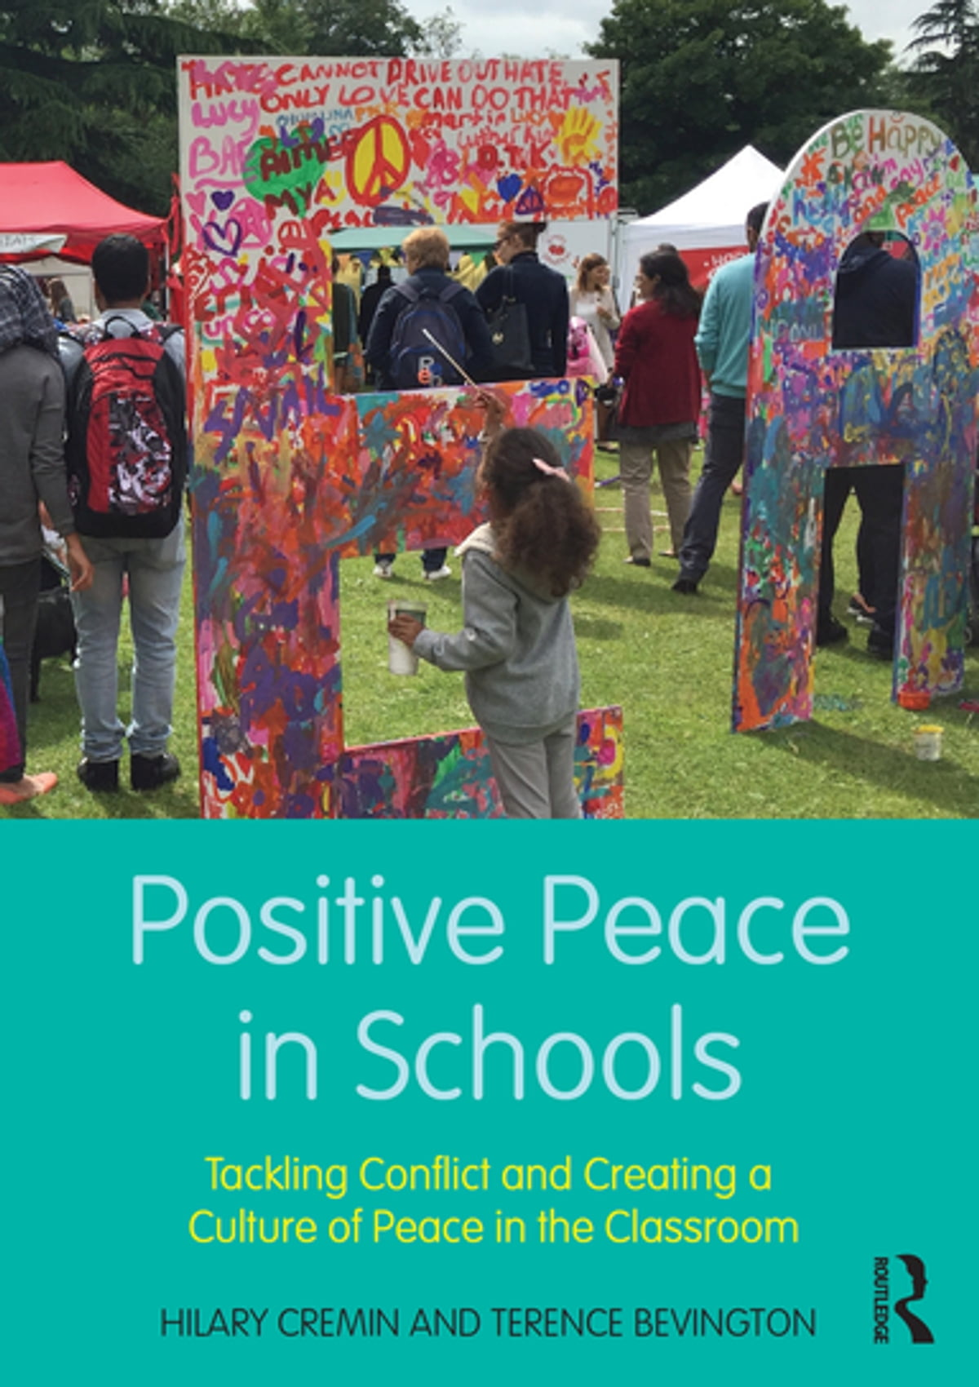

Slide 4
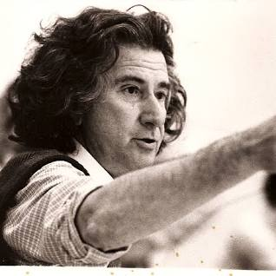
Theatre itself is not revolutionary.
It is a rehearsal for the revolution.
Augusto Boal
Theatre of the oppressed

Slide 5
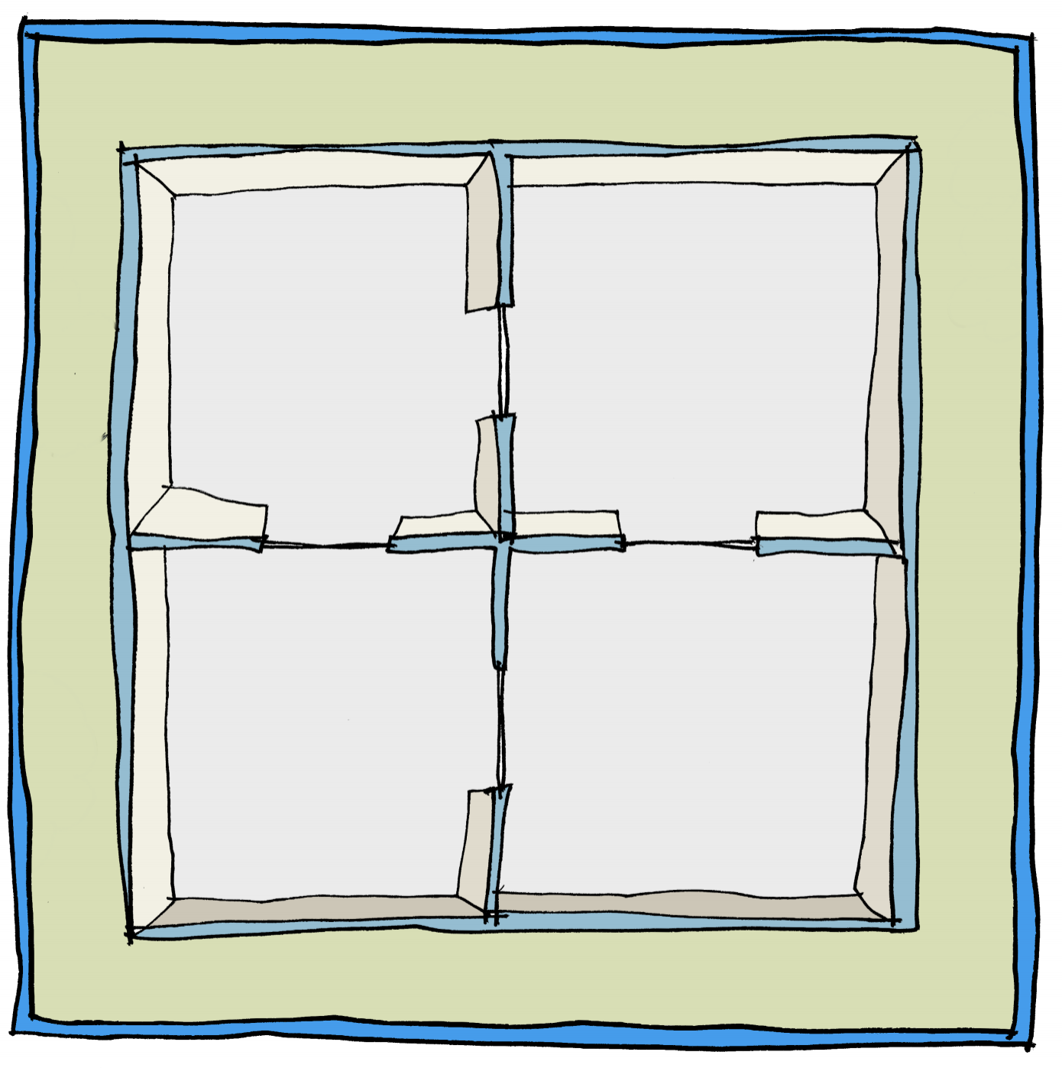
The Four Essential Questions
What?
Why?
Не?
Неге?
Что?
Почему?
How?
Who?
Қалай?
Кім?
Как?
Кто?

Slide 6
Only connect the prose and the passion, and both will be exalted, and human love will be seen at its height. Live in fragments no longer.
E.M. Forster

Slide 7

The Three 'T's of Global Citizenship Education
The solution lies in the concentration of the three forces of pedagogy, technology and change knowledge. If you want to head off destruction, we need to make it all about learning, let technology permeate, and engage the whole system.
Michael Fullan
Stratosphere - 2012

Slide 8


Slide 9




Many Peaces
ubuntu
The Sanskrit word shanti means inner serenity and is found in the traditions of Hinduism, Buddhism and Sikhism
The Hebrew word Shalom and Arabic and Aramaic salaam and shlama, have the sense of wholeness, fulfillment, wellbeing
Ubuntu is found in diverse forms in many parts of Africa, especially among the Bantu languages of East, Central and Southern Africa. It is a cultural worldview that captures the essence of what it means to be human.
“The question of real, lasting world peace concerns human beings, so basic human feelings are also at its roots. Through inner peace, genuine world peace can be achieved. In this the importance of individual responsibility is quite clear; an atmosphere of peace must first be created within ourselves, then gradually expanded to include our families, our communities, and ultimately the whole planet”.
Tenzin Gyatso, the 14th Dalai Lama, cited in Mayton II, 2009: 61

Slide 10
Conflict
Constructive
Destructive
Peace
Violence
Positive
Negative
Direct
Indirect
Social justice
Structural
Cultural

Slide 11
Positive Peace Theory
Three forms of violence:
Direct
Structural
Cultural
Positive and negative peace
Negative – absence of direct violence
Positive – absence of structural and cultural violence
Galtung, J. (1970). Pluralism and the future of human society. Challenges for the future: Proceedings from the Second International Futures Research Conference, Norway, 271-308.
Three ways of bringing about peace:
Peace-keeping
Peace-making
Peace-building

Slide 12
Inner Peace
Outer Peace
Community and
Ecological Peace
Global Peace
WELLBEING
RELATIONSHIPS
CITIZENSHIP
COSMOS
Building capacity for peace and wellbeing, and for new ways of thinking, knowing, and being.
Learning self-awareness, self-acceptance, self-control and self-expression.
Developing healthy relationships and learning to work with diverse others.
Understanding and reflecting on interpersonal conflict resolution styles and conflict literacy.
Reaching out across communities and the world.
Reflecting and articulating the human values of global citizenship, critical awareness, non-violence and care, and evaluating participation in school-based, local and global peace-making programmes.
Learning to care for the planet, and to be ‘in love’ with life.
Going beyond the anthropocene and honouring the more than human.
Peace-building
GROWTH
& CHANGE
The Positive Peace Matrix
Prof Hilary Cremin and Roy Leighton
Addressing inner conflicts, and providing opportunities for restoration and healing.
Resolving conflict nonviolently, using the full spectrum of conflict resolution strategies.
Addressing conflict in school and communities, and engaging in local and global peacemaking programmes.
Rewilding projects and reconnecting with Nature.
Peace-making
RESTORATION
Protecting personal boundaries, mental health, and wellbeing.
Protecting rights and responsibilities, and keeping people safe.
Protecting local, and global communities, and our school community
Protecting the planet and its ecosystems.
Peace-keeping
PRESERVATION

Slide 13
Restorative Approaches
Restorative Questions:
What happened?
What were you thinking and feeling at the time?
What are your thoughts and feelings since?
Who has been affected?
In what way?
What do you need [to do] to put things right?

Slide 14
What changes will this make?

Slide 15
STUDENTS: Students will know how to...
Inner peace
Protect personal boundaries, mental health and wellbeing
Address inner conflicts, restore wellbeing, and achieve healing
Accept, control, understand, and express themselves
Develop peaceful ways of thinking, knowing and being.
Outer peace
Protect the rights and responsibilities of others
Resolve conflict well, using a range of strategies
Reflect on and improve their conflict literacy
Maintain healthy relationships and work well with diverse others.
Community and global peace
Protect a peaceful school community
Work for peace at local, national and global levels
Reflect on their engagement in school-based, local and global peace-making initiatives
Articulate the values of global citizenship, critical awareness, non-violence and care.
Ecological peace
Protect the planet and its ecosystems
Reconnect with Nature
Care for the planet, and to be ‘in love’ with life
Go beyond the Anthropocene and honour the more-than-human.

Slide 16
SCHOOLS: Schools will...
Protect the personal boundaries, rights, mental health, and wellbeing of staff and students
Create safe, peaceful and high-quality learning spaces
Develop the conflict literacy of staff and students, and their ability to reflect on and improve positive responses to conflict
Provide policy, curriculum, resources, training, and physical spaces for staff and students to address conflicts, restore wellbeing, and achieve healing
Teach students to accept, control, understand, and express themselves, and to develop peaceful and sustainable ways of thinking, knowing and being.
Provide an environment where peaceful and healthy relationships at all levels can thrive.
Ensure culturally appropriate diversity (gender, ethnicity, sexual orientation, etc.) in leadership roles throughout the school, and in teaching, learning and curriculum spaces
Provide opportunities and support for staff and students to work for local, national global, and environmental peace
Teach students to be reflexive, critically aware, compassionate global citizens
Provide opportunities for students to reconnect with Nature, care for the planet, and explore their own sense of being ‘in love’ with life.

Slide 17
HIGH
PUNITIVE
RESTORATIVE
TO
WITH
Restorative Justice
authoritarian
authoritative
Social Discipline
Control (limit setting, discipline)
NEGLECTFUL
PERMISSIVE
Window
NOT
FOR
irresponsible
paternalistic
LOW
HIGH
Support (encouragement, nurture)

Slide 18
Restorative Window
HIGH
and Compromise
TO
WITH
Certainty is the greatest of all illusions: whatever kind of fundamentalism it may underwrite, that of religion or of science, it is what the ancients meant by hubris . The only certainty, it seems to me, is that those who believe they are certainly right are certainly wrong.
Dr Iain McGilchrist The Master and His Emissary
Compromise
Concern for self
NOT
FOR
LOW
HIGH
Concern for others

Slide 19
HIGH
To
With
Restorative Window
Competition
Collaboration
and Five
Compromise
Concern for self
Conflict Styles
Not
For
Avoidance
Accomodation
LOW
HIGH
Concern for others

Slide 20
DICTATOR
SAVIOUR
Competition
Collaboration
WARRIOR
PEACEMAKER
The Cremin/Leighton
WISDOM
Literacy Window
Conflict and Peace
PEACEBUILDER
PEACEKEEPER
FACILITATOR
Avoidance
Accommodation
BYSTANDER
SERVANT

Slide 21

Transition

Slide 22
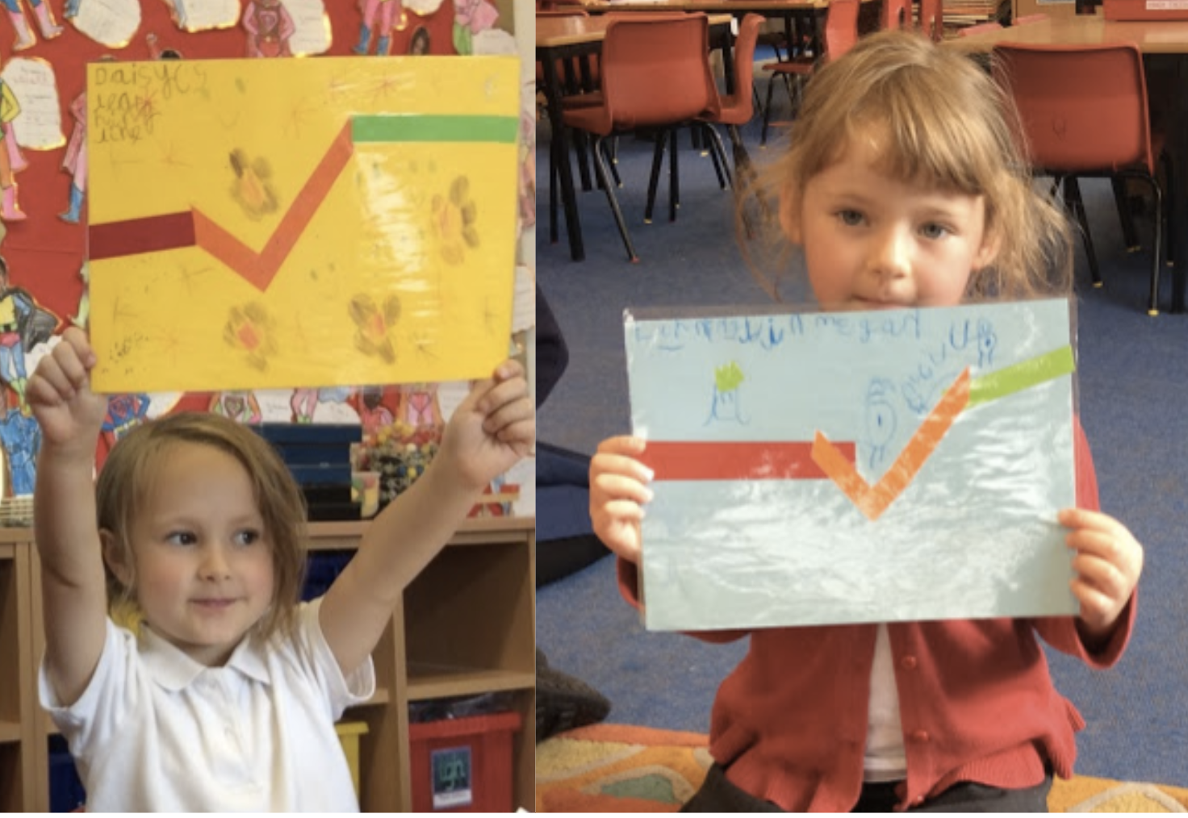

Simple Systems
The Peace Process:
with Feedback

Slide 23
The Five Stages of Change

Slide 24
The Process of Change
Purpose
Evaluate
Understand
Act
Plan

Slide 25
Changing the narrative - The Hero's Journey
The Call to Adventure
Return with
Acceptance
the Elixir
of the Call
The Path
Crossing the
of Trials
Threshold

Slide 26
The archetypes and three peaces change process
Dictator
Bystander
Warrior
Warrior
Facilitator
Peacekeeper
Peace Building
Peace Keeping
Peacemaker
Facilitator
Servant
Saviour
Peace Making

Slide 27
Positive Peace
Peace Keeping
Peace Building
Peace Making

Slide 28
Negative Peace
Peace Building
Peace Keeping
Peace Making

Slide 29
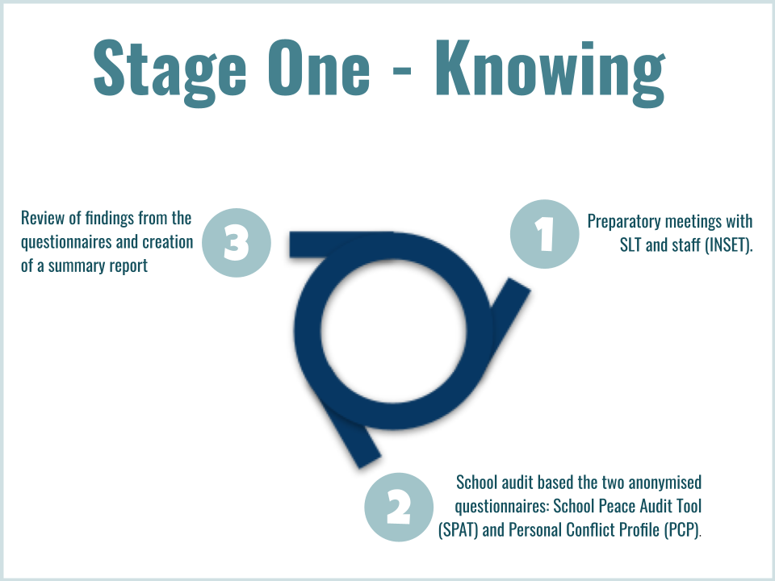
Phase One - Know

Slide 30
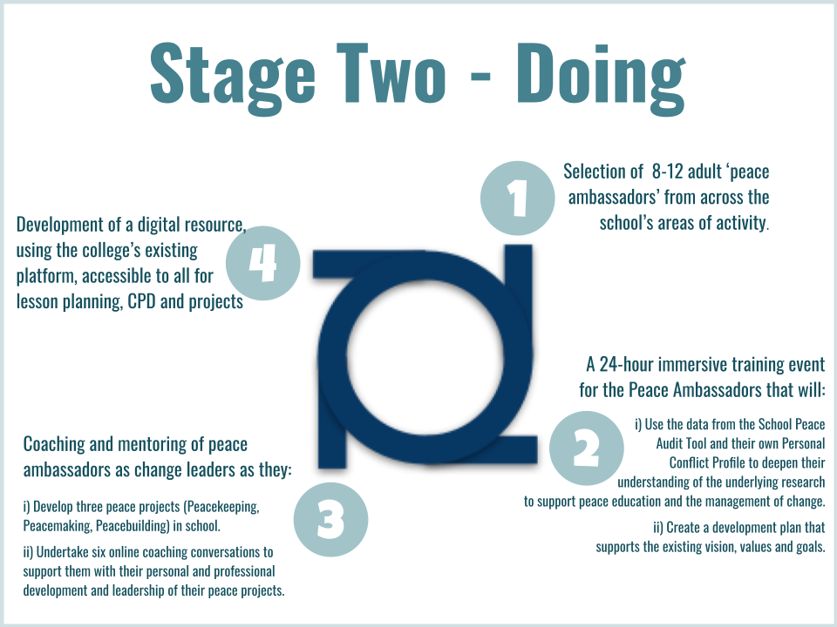
Phase Two - Do

Slide 31
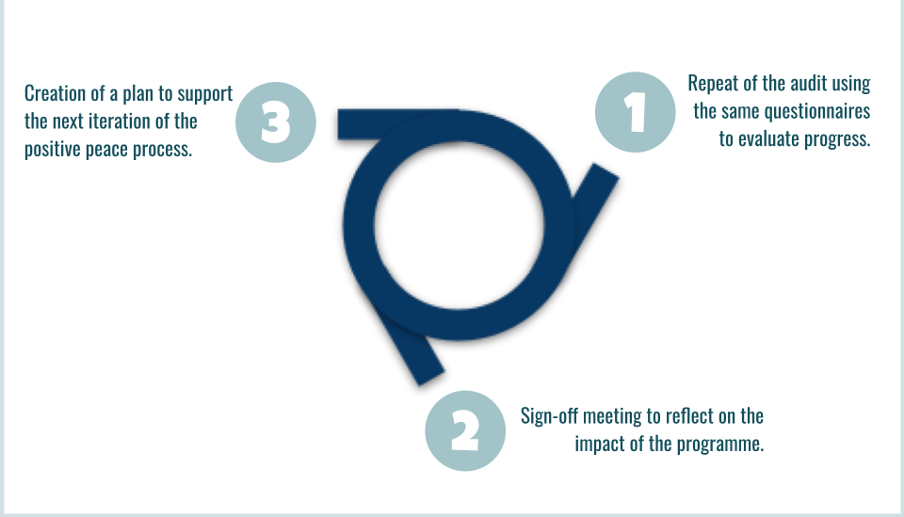
Phase Three - Be

Slide 32
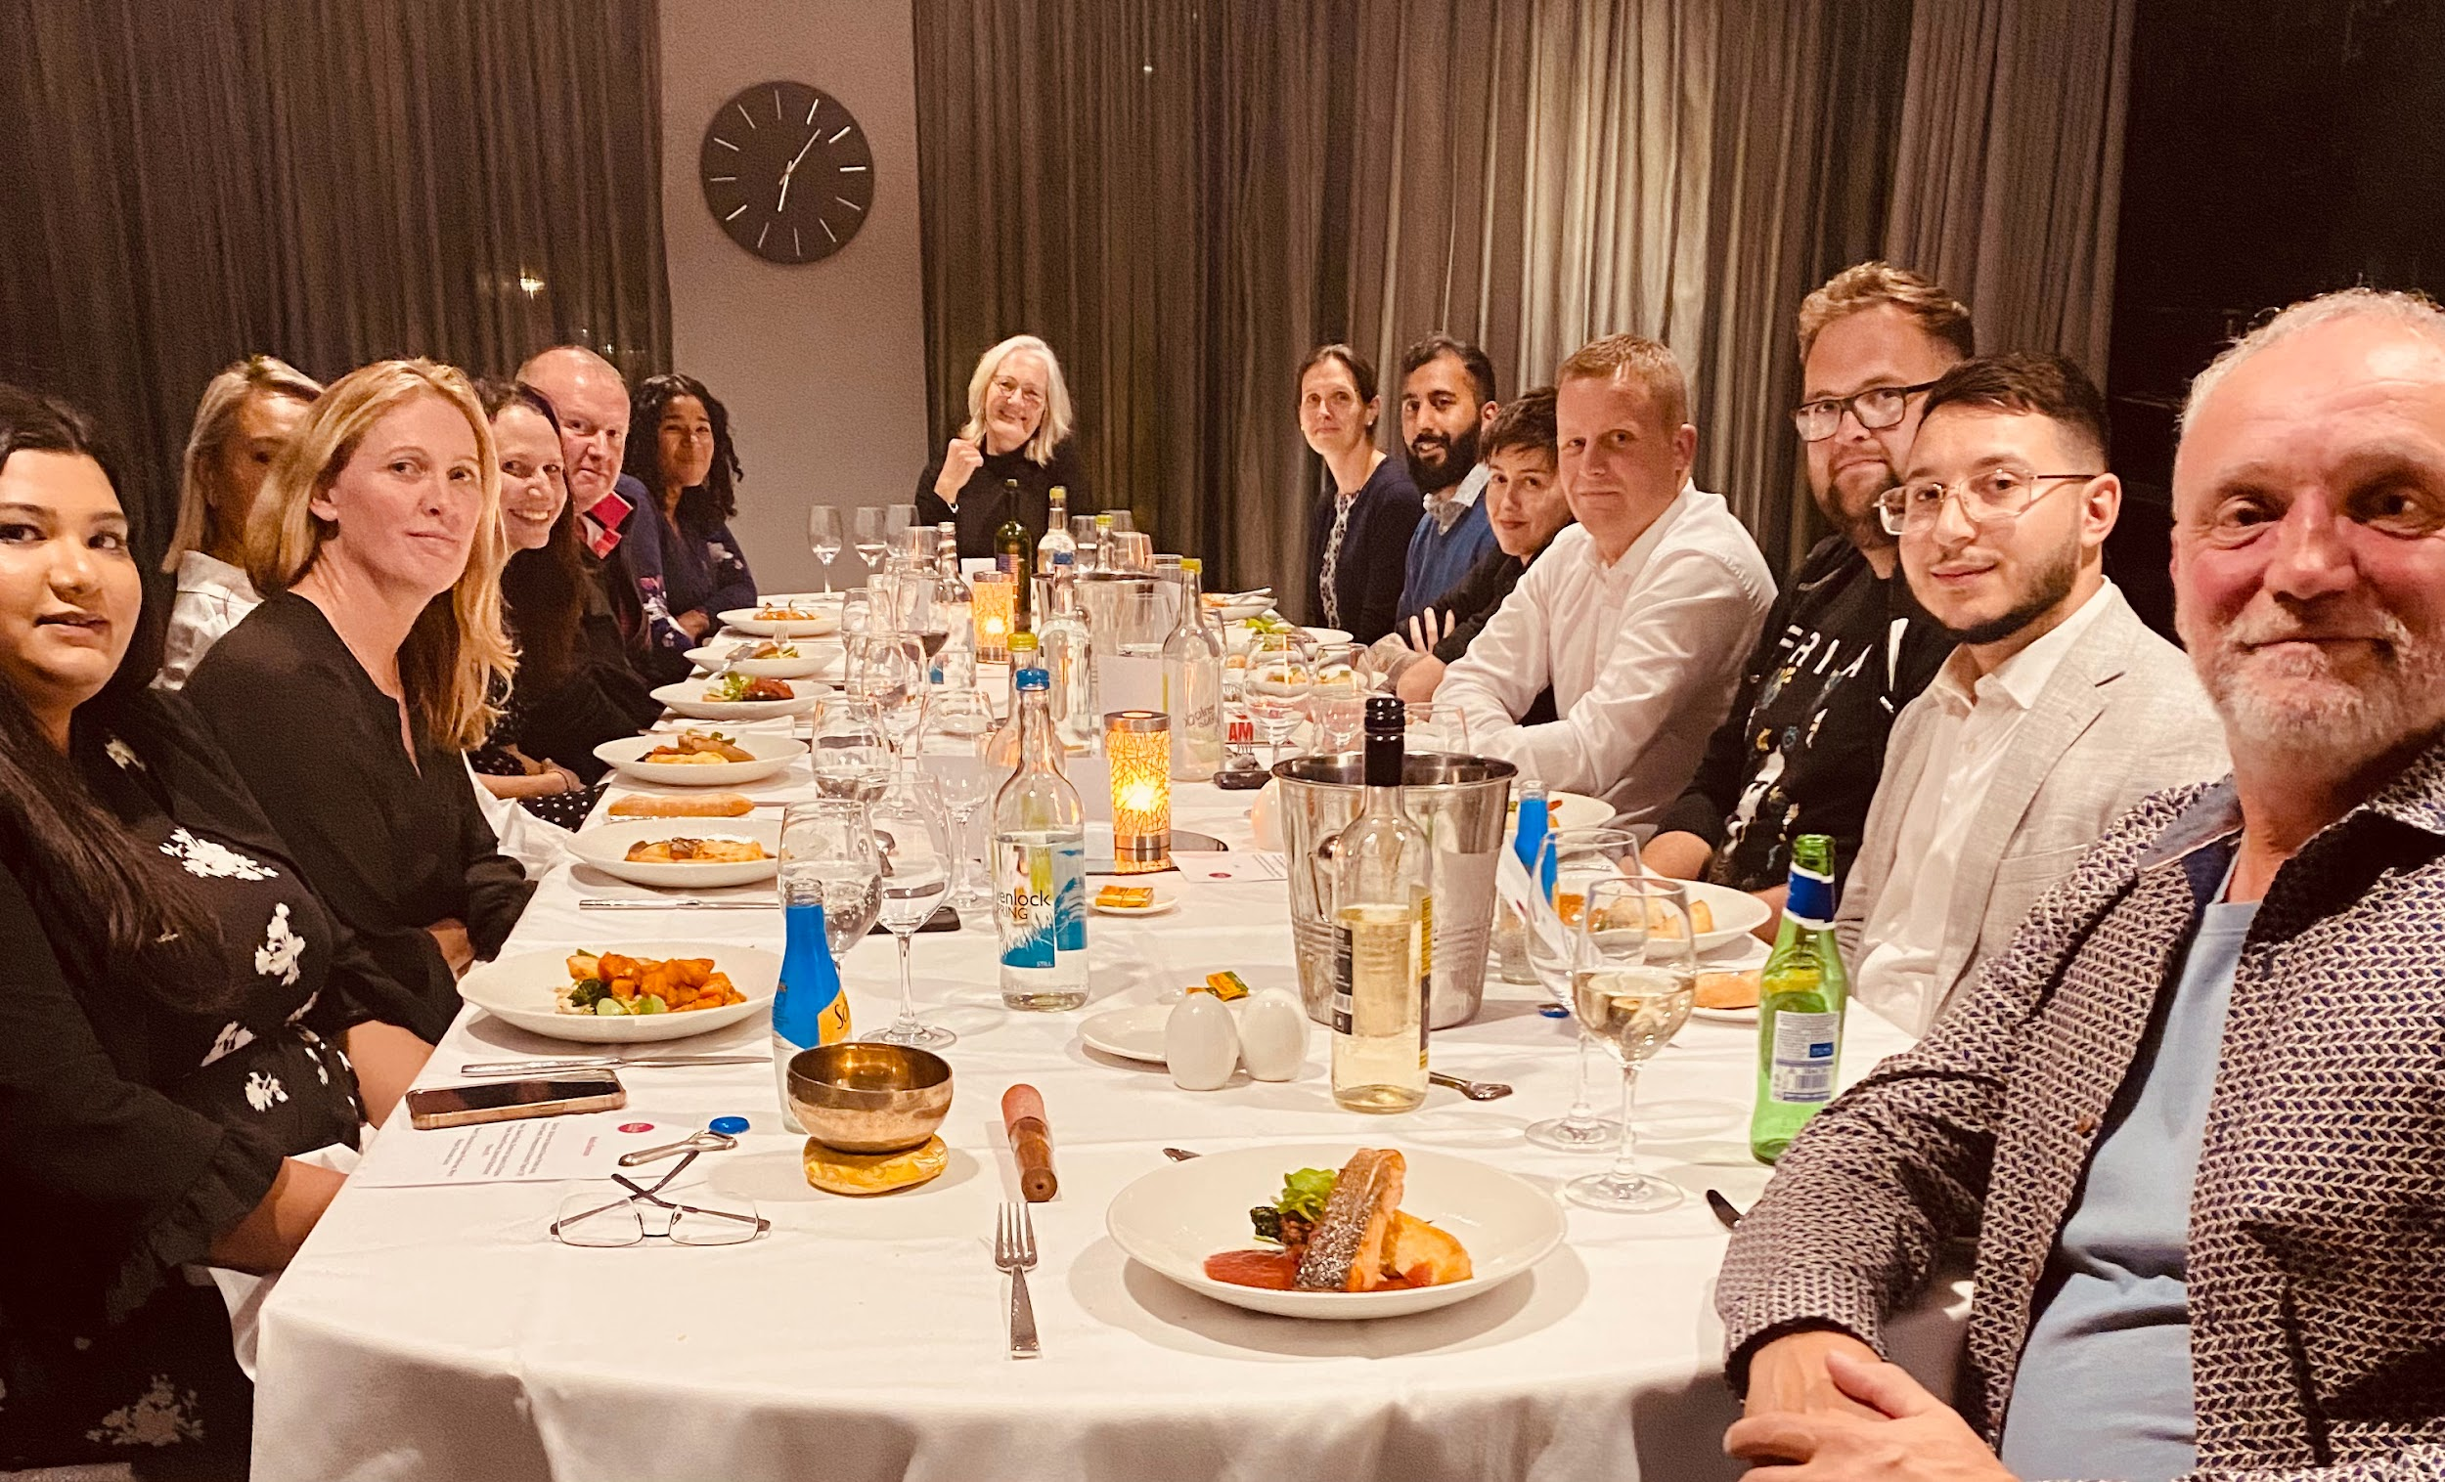
Socratic Dinner (end of day one) Holte Secondary School - Birmingham

Slide 33
The Six Conditions for Change
There must first be the Potential for change.
There needs to be a genuine openness to find Solutions to solve current and previous problems.
The need to accept and embrace the fact that Dissonance is always going to be an outcome of any change process.
The willingness and ability to honestly identify and deal with the Barriers to change.
Be open to a new and honest Insight into what hasn’t worked and what the possible alternatives are.
Finally, there must be Consolidation and support throughout the process of change.
Dr Clare W. Graves

Slide 34


Slide 35
The stages of data analysis:
Collection
Organization
Helping the data
Tell a Story
The Visual Display:
Interpretation
Presentation
Notes:
These are the four essential stages of data analysis: we need to gather data from respondents, arrange it in a way in which it can be analysed, look for the meaning in the data, and display our findings in some meaningful way.

Slide 36
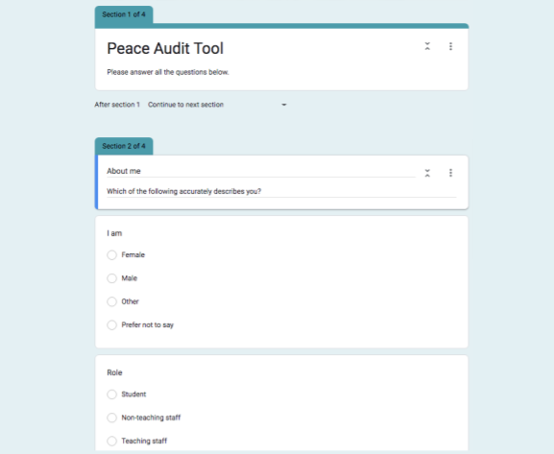
Positive Peace Audit Tool
1. Collection
Notes:
We collect data using web-based forms which can be completed on a smartphone, tablet or computer, or even on paper if there is no way of delivering the form by internet.

Slide 37
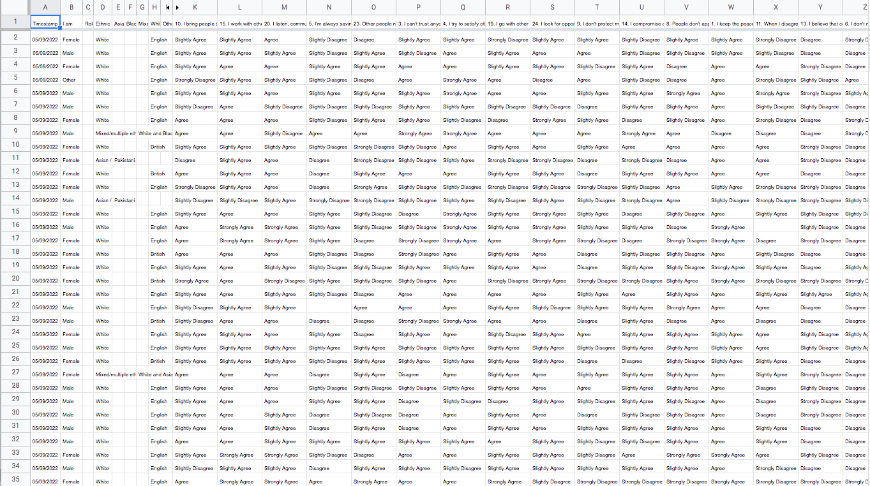
2. Organization
Notes:
As soon as the responses start to arrive from people completing the survey, we are able to organise it in a database or simple spreadsheet.

Slide 38
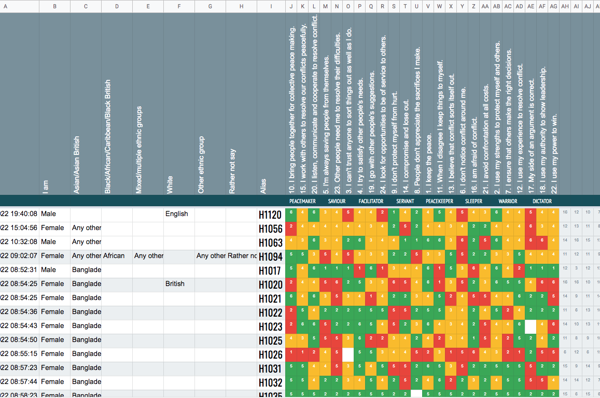
3. Interpretation
Notes:
Using colour and graphical representations, we can begin to visualise the data so that numbers and text responses turn into pictures.

Slide 39
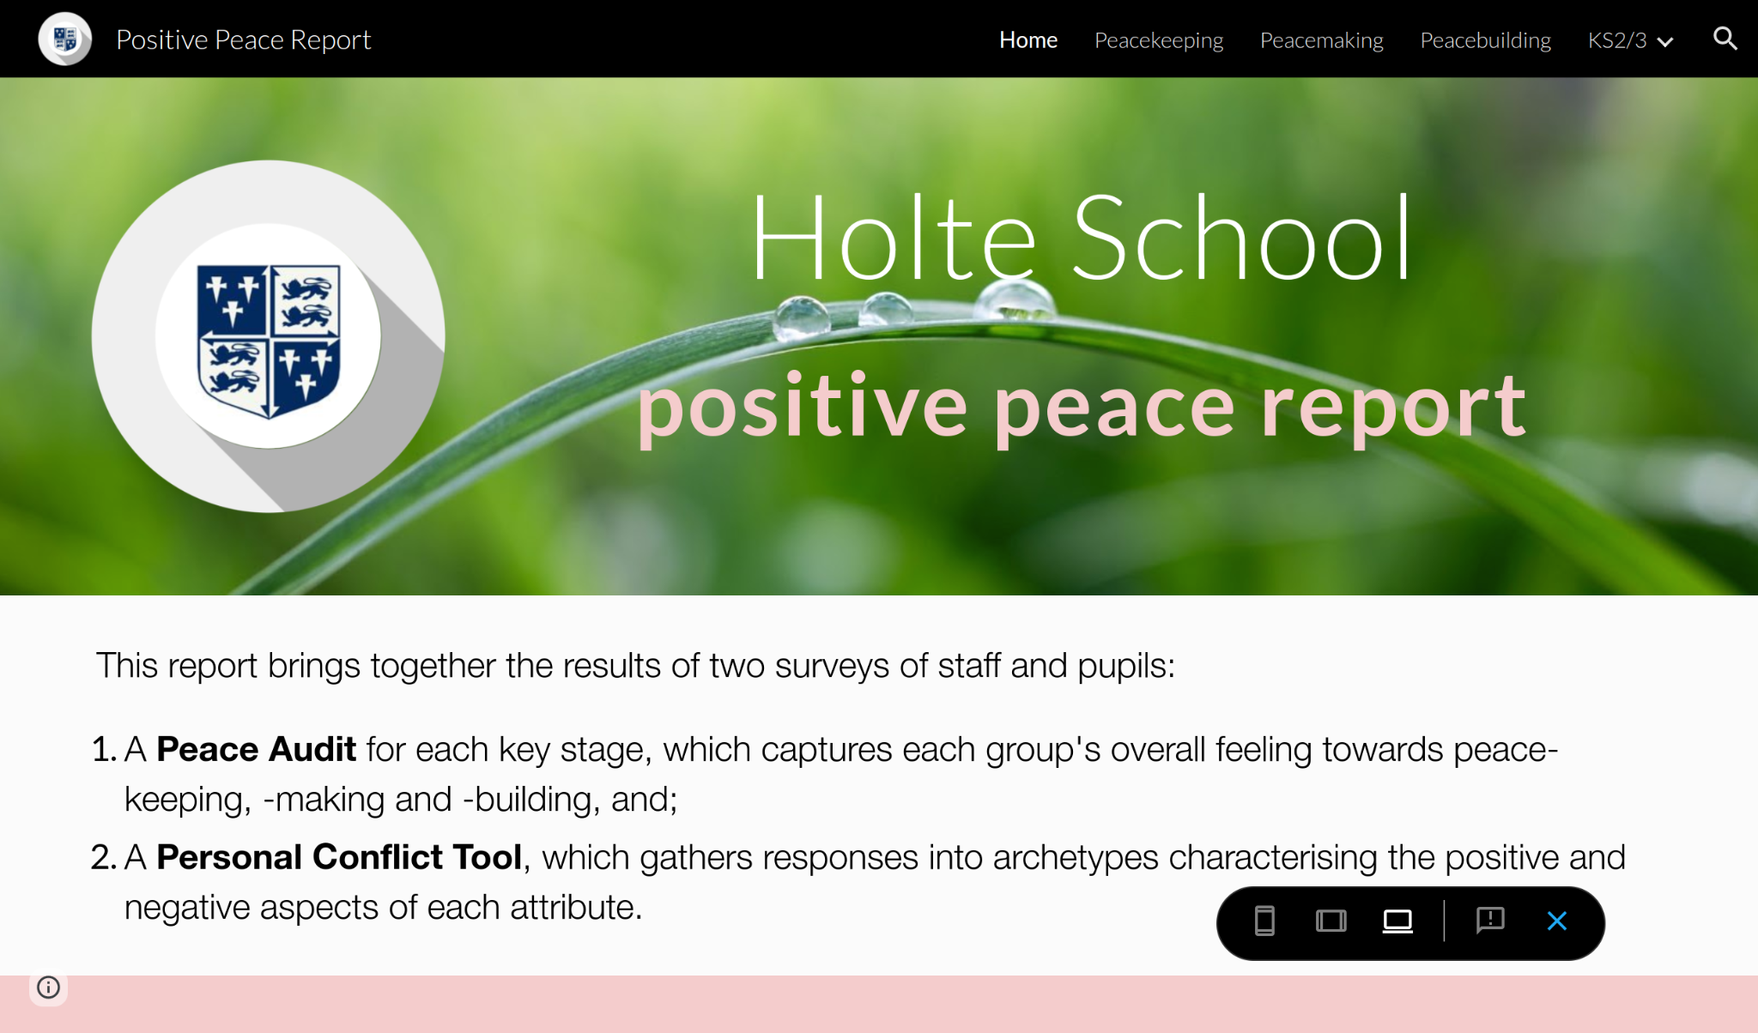
Home Peacekeeping Peacemaking Peacebuilding
Positive Peace Toolkit
4. Presentation
Notes:
Rather than producing dull reports, we construct a dynamic dashboard with simple navigation to offer our users a more engaging way of accessing the data.

Slide 40
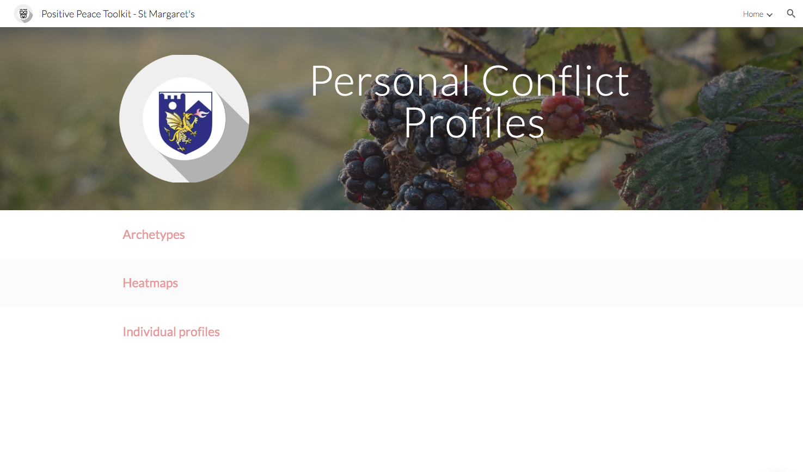
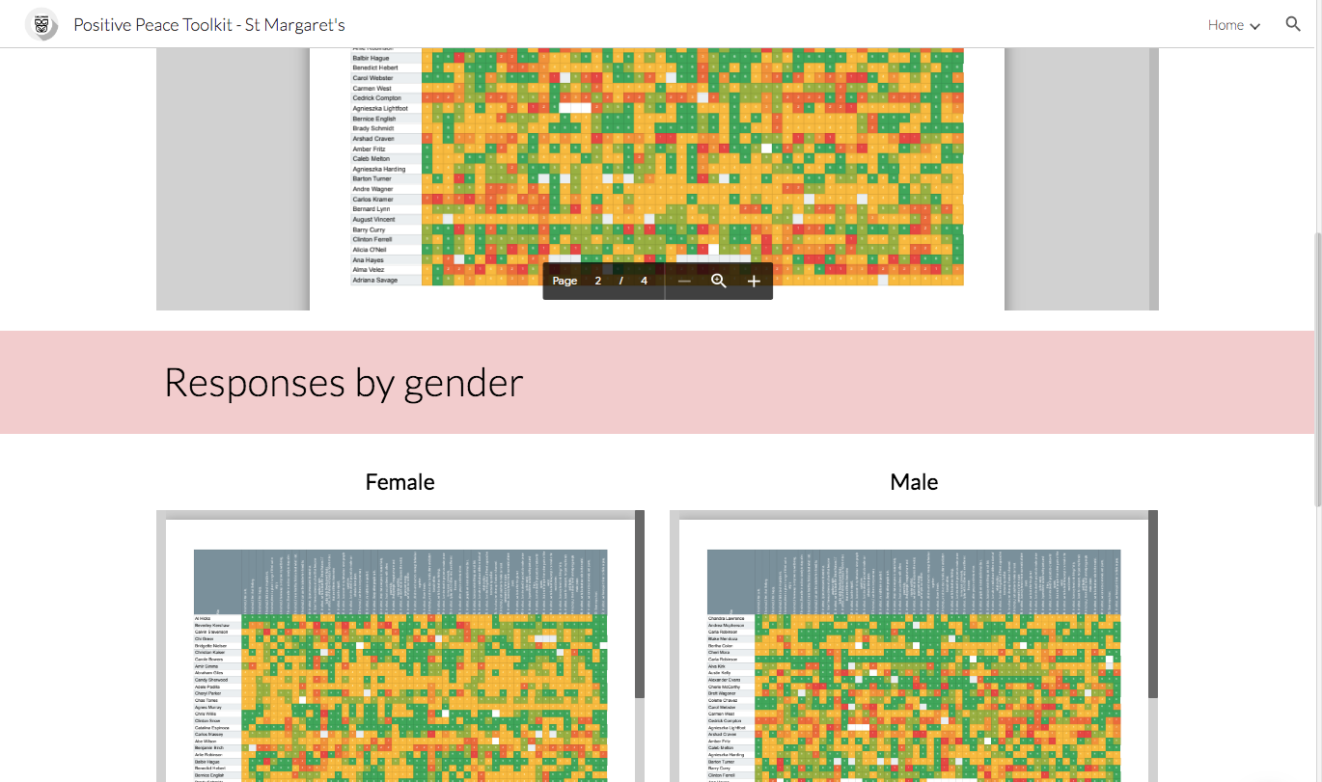
Personal Conflict Tool
Notes:
Some of the data allows a high-level view of your entire organisation…

Slide 41
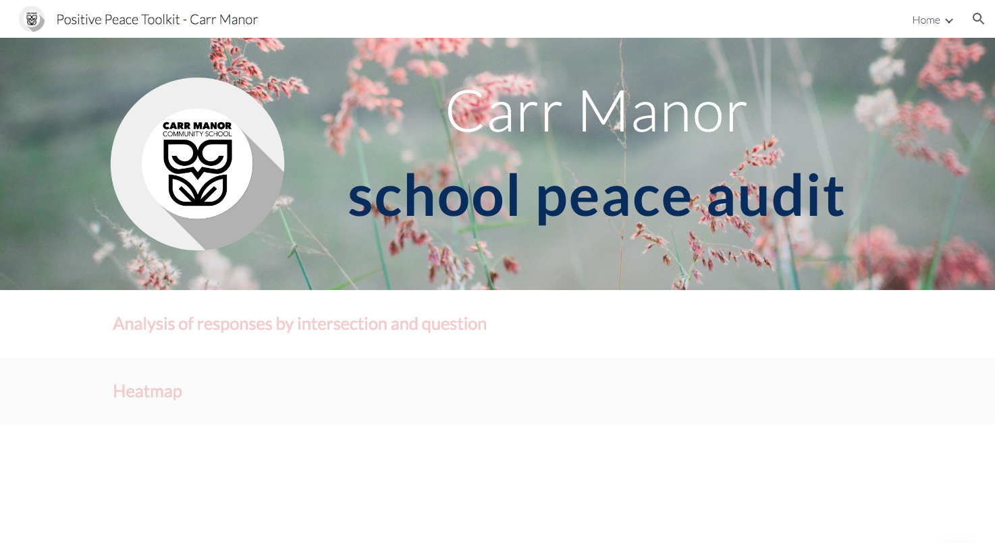
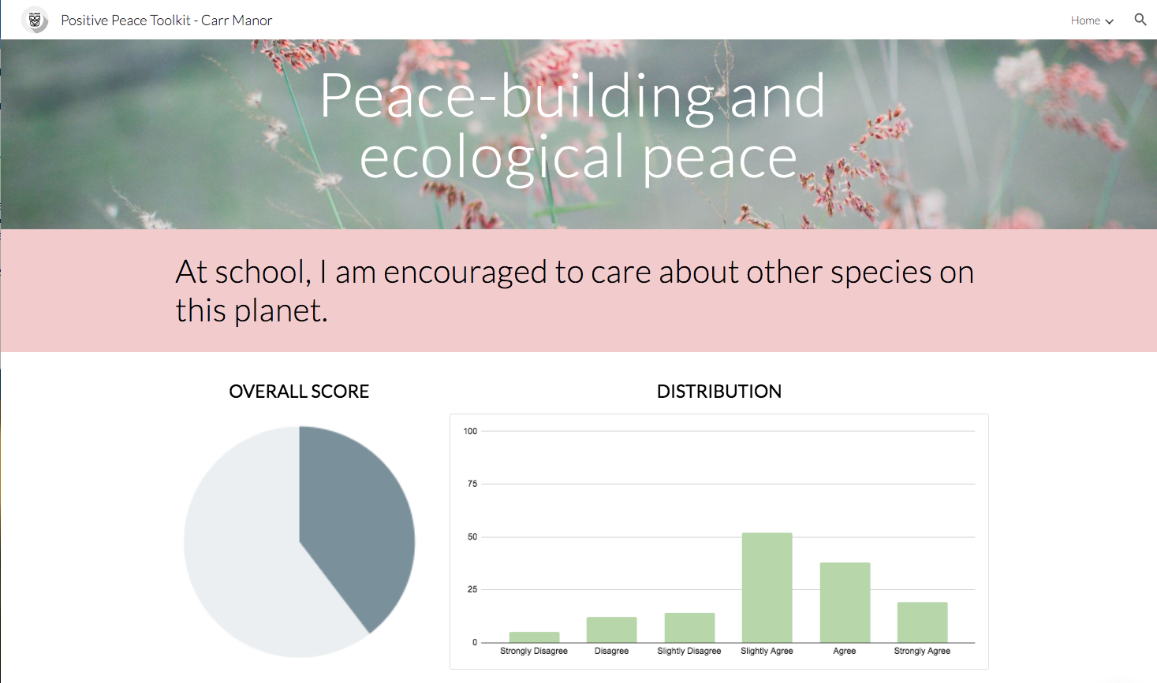
Positive Peace Audit Tool
Notes:
The charts and tables we embed in the dashboard are dynamic, and update automatically and in real-time as fresh data arrives.

Slide 42
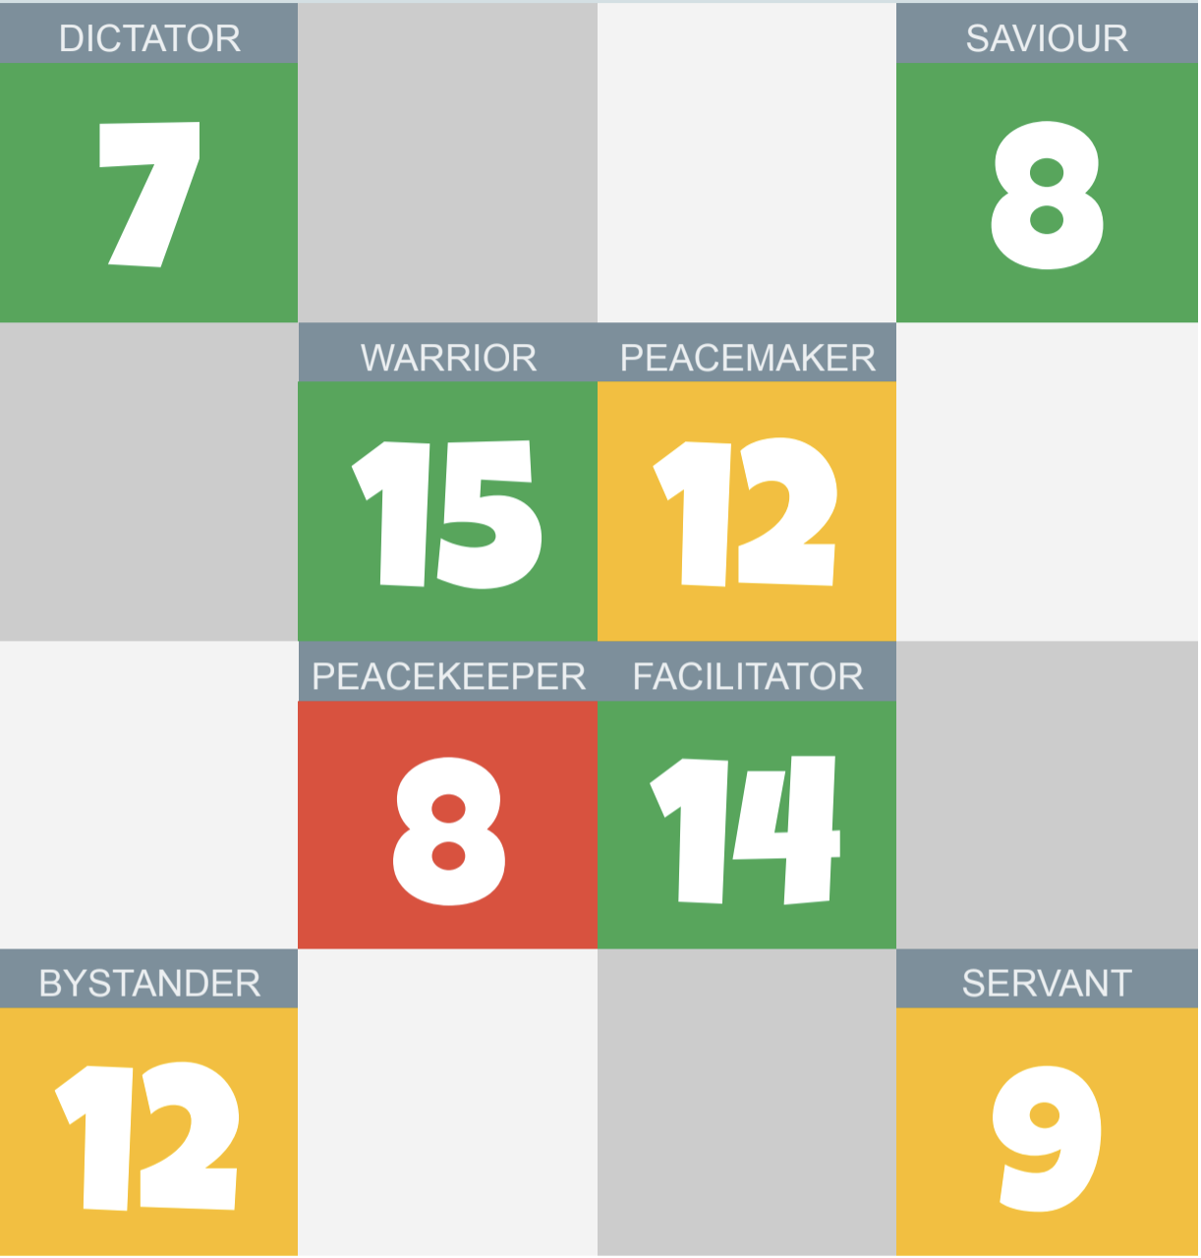
Personal Conflict Tool
Notes:
…while some allows the analysis and profiling of individual respondents.

Slide 43

The Neurology of Peace
‘The optimal environment for anyone to learn anything in is best summarised by the following algorithm:
If a person feels understood as an individual human being then…
their self-esteem is increased; and if their self-esteem is increased then…
their self-confidence will be good; and if they are in an environment where they feel understood, where their self-esteem is good and where their self-confidence is good then they feel…
engaged; and, if they feel emotionally engaged, then their neurochemistry will be optimised for learning.
And what is this but ‘love’ in the pure sense of that word?’
Dr Andrew Curran
The Big Book of Independent Thinking

Slide 44
The Neurology of Peace
‘Everyone you meet is an individual human. The more they feel the four elements above when they are with you, the more they will learn from you.
And do you know the best thing about all this? This chapter represents a precis of billions of dollars’ worth and many years of research, and what has it told us?
Exactly what any village wise woman has been able to tell us for the past ten thousand years. Neat, huh?
Dr Andrew Curran
The Big Book of Independent Thinking

Slide 45
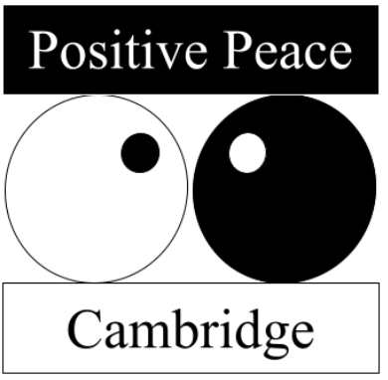
Thank you.
For more information, visit:
www.positivepeacecambridge.org
or email:
roy@positivepeacecambridge.org

Slide 46
Summary Slides

Slide 47

We do not see the world as it is. We see the world the way we think it is.
Aristotle

Slide 48
Inner Peace
Outer Peace
Community and
Ecological Peace
Global Peace
WELLBEING
RELATIONSHIPS
CITIZENSHIP
COSMOS
Building capacity for peace and wellbeing, and for new ways of thinking, knowing, and being.
Learning self-awareness, self-acceptance, self-control and self-expression.
Developing healthy relationships and learning to work with diverse others.
Understanding and reflecting on interpersonal conflict resolution styles and conflict literacy.
Reaching out across communities and the world.
Reflecting and articulating the human values of global citizenship, critical awareness, non-violence and care, and evaluating participation in school-based, local and global peace-making programmes.
Learning to care for the planet, and to be ‘in love’ with life.
Going beyond the anthropocene and honouring the more than human.
Peace-building
GROWTH
& CHANGE
The Positive Peace Matrix
Prof Hilary Cremin and Roy Leighton
Addressing inner conflicts, and providing opportunities for restoration and healing.
Resolving conflict nonviolently, using the full spectrum of conflict resolution strategies.
Addressing conflict in school and communities, and engaging in local and global peacemaking programmes.
Rewilding projects and reconnecting with Nature.
Peace-making
RESTORATION
Protecting personal boundaries, mental health, and wellbeing.
Protecting rights and responsibilities, and keeping people safe.
Protecting local, and global communities, and our school community
Protecting the planet and its ecosystems.
Peace-keeping
PRESERVATION

Slide 49
The Four Essential Questions
What?
Why?
Не?
Неге?
Что?
Почему?
How?
Who?
Қалай?
Кім?
Как?
Кто?

Slide 50
DICTATOR
SAVIOUR
Competition
Collaboration
WARRIOR
PEACEMAKER
The Cremin/Leighton
WISDOM
Literacy Window
Conflict and Peace
PEACEBUILDER
PEACEKEEPER
FACILITATOR
Avoidance
Accommodation
BYSTANDER
SERVANT

Slide 51
The Five Stages of Change

Slide 52
The Process of Change
Purpose
Evaluate
Understand
Act
Plan

Slide 53
Changing the narrative - The Hero's Journey
The Call to Adventure
Return with
Acceptance
the Elixir
of the Call
The Path
Crossing the
of Trials
Threshold

Slide 54
The Neurology of Peace
‘The optimal environment for anyone to learn anything in is best summarised by the following algorithm:
If a person feels understood as an individual human being then…
their self-esteem is increased; and if their self-esteem is increased then…
their self-confidence will be good; and if they are in an environment where they feel understood, where their self-esteem is good and where their self-confidence is good then they feel…
engaged; and, if they feel emotionally engaged, then their neurochemistry will be optimised for learning.
And what is this but ‘love’ in the pure sense of that word?’
Dr Andrew Curran
The Big Book of Independent Thinking

